Slide 1
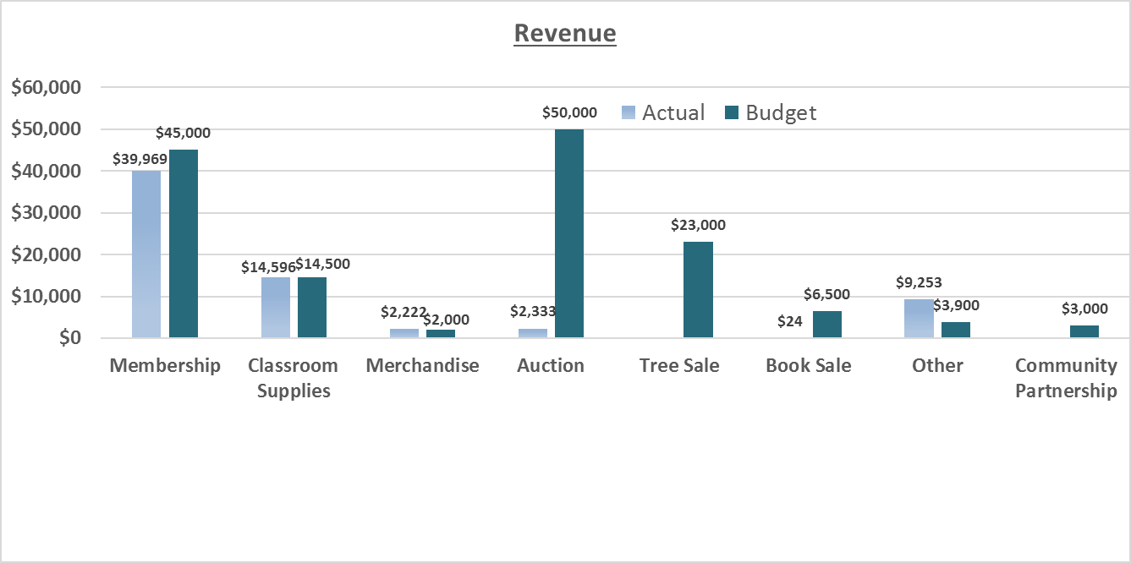
Revenue through October 2017

Slide 2
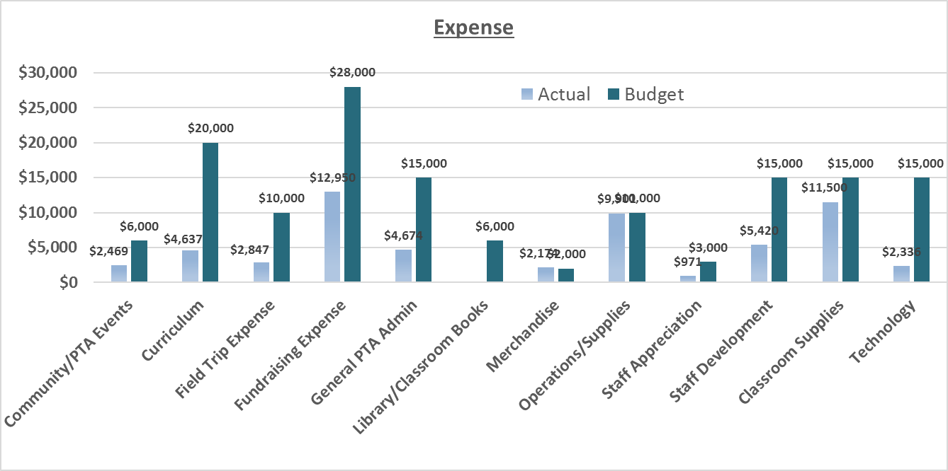
Expenses through October 2017

