Slide 1
Tips and Tricks for Rising 4th Graders

Slide 2
Outcomes for this session
Understand the basic structure for departmentalized 4th grade at Ross
Understand ways to support the following...
Social/Emotional Trends for 9 and 10 year-olds
Reading Behaviors for Rising 4th Graders
Mathematics for Rising 4th Graders

Slide 3
Schedule
Departmentalization
Sample schedule
Shifts in expectations/rigor
Social Emotional Trends of 9/10 year-olds
Humanities Overview
STEM Overview
Skills to prioritize this summer
Q & A

Slide 4
Departmentalization
Humanities (2 hours)
Reading (Close reading & Guided Reading)
Writing
Social Studies
STEM (2 hours)
Science
Math
Switch classrooms
Move as a class
Teachers/educational aides manage transitions

Slide 5
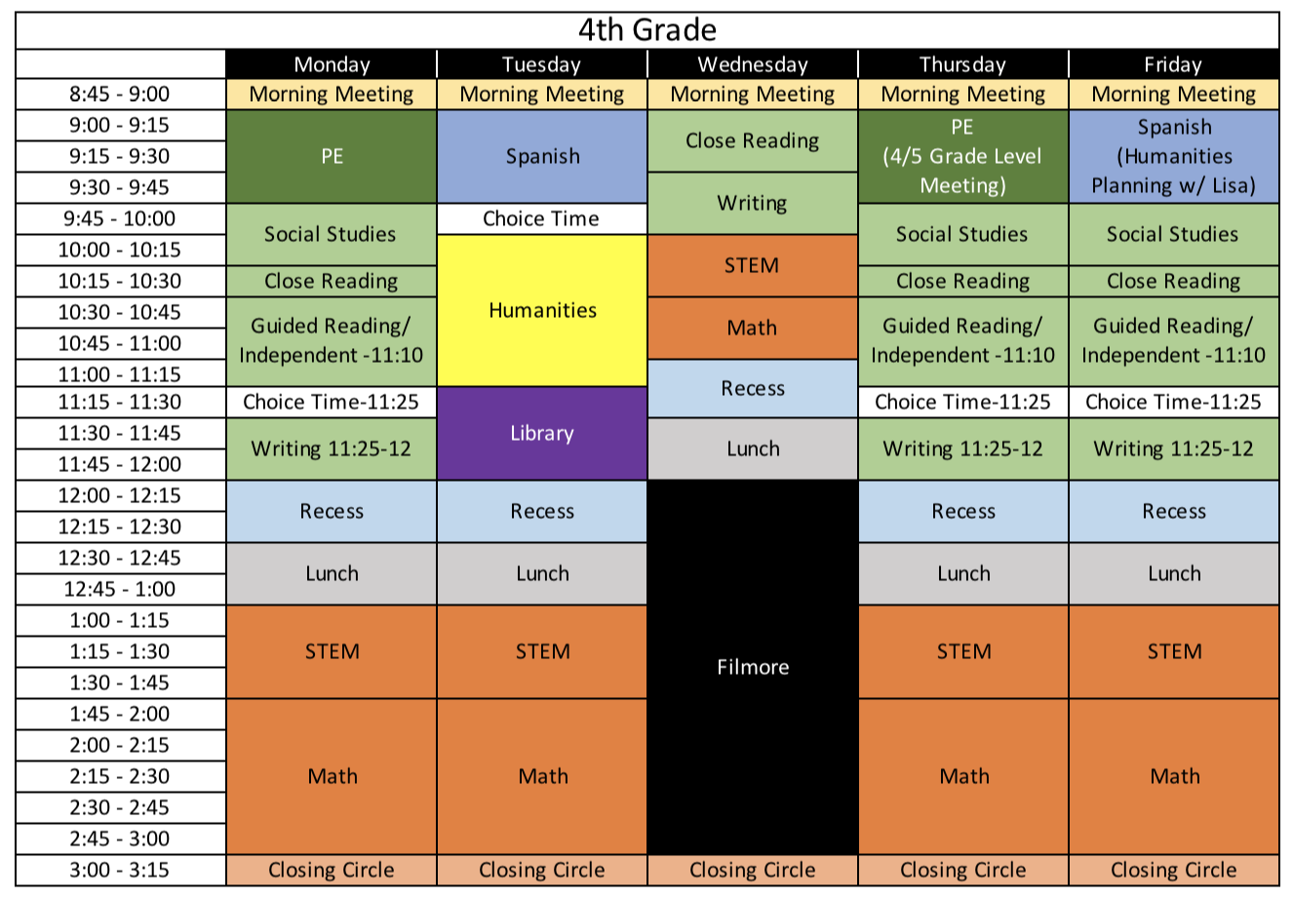
Sample schedule

Slide 6
Increased responsibility and independence
Longer independent work times
Humanities: weekly schedule, to-do lists
STEM: scientific procedures
Keeping track of materials
Agendas to record homework, announcements, important dates

Slide 7
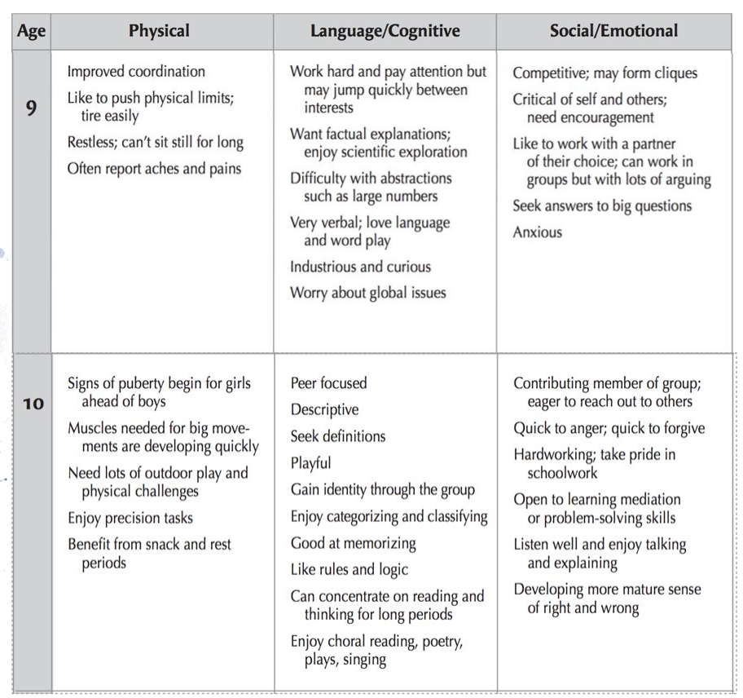
Social Emotional needs of 9 & 10 year old's

Slide 8
Humanities Overview
Unit Topics
1. Early America
2. My Story
3. American Revolution and Independence
4. Constitution and Founding Fathers
5. Heroic Adventures and Greek Mythology

Slide 9
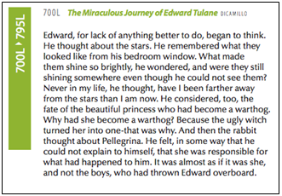
Reading Expectations
By the end of third grade, we hope children read texts at or around "Level P" or Lexile Levels 600-800.

Slide 10
Reading Behaviors to Observe
Word-solving and Fluency
Actively acquires new vocabulary through reading
In oral reading, figures out new words rapidly while reading smoothly, with fluency, phrasing and expression
While reading silently, reads rapidly and with attention to meaning

Slide 11
Reading Behaviors to Observe
Reading stamina and volume
Demonstrates interest in reading an extended text over a longer time period
Sustains attention to a text read over several days, remembering details and revising interpretations as new events are encountered

Slide 12
Reading Behaviors to Observe
Thinking about and beyond the text!
After reading silently, demonstrates understanding and sophistication in interpreting meaning
Compares the text with other books in an analytic way
Goes beyond the text to speculate on alternative meanings
Shows the ability to summarize and extend the text in writing

Slide 13
STEM Overview
Math
Place value, rounding, and using the standard algorithm for addition and subtraction within 1,000,000
Unit conversions/problem-solving with metric measurements
Multi-digit multiplication and division
Fraction equivalence, ordering, and operations
Decimal fractions
Exploring multiplication
Angle measure and plane figures
Science
Organism Structure and Behavior
Changes Over Time to Earth’s Surface and Resources
Using Energy Transformations
Communicating Using Wave Energy

Slide 14
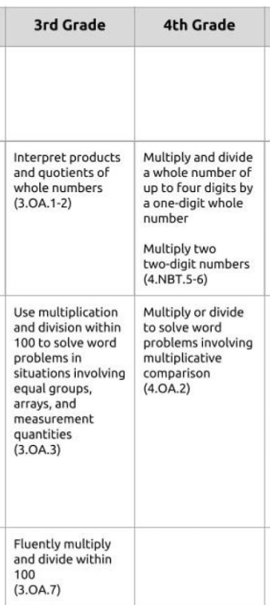
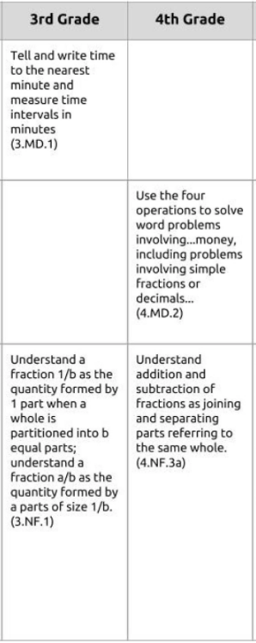
Progression of skills

Slide 15
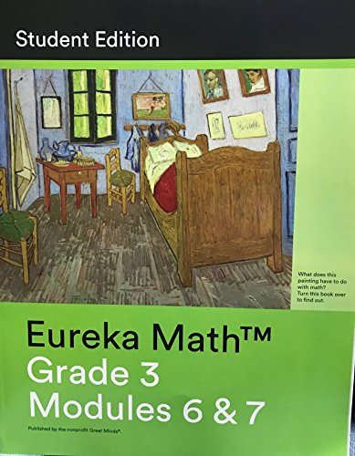
Reinforce 3rd grade skills
Eureka Math
Your child can work to complete any lessons that were skipped in their workbooks (Modules 6 & 7)
Lessons videos are posted on greatminds.org

Slide 16
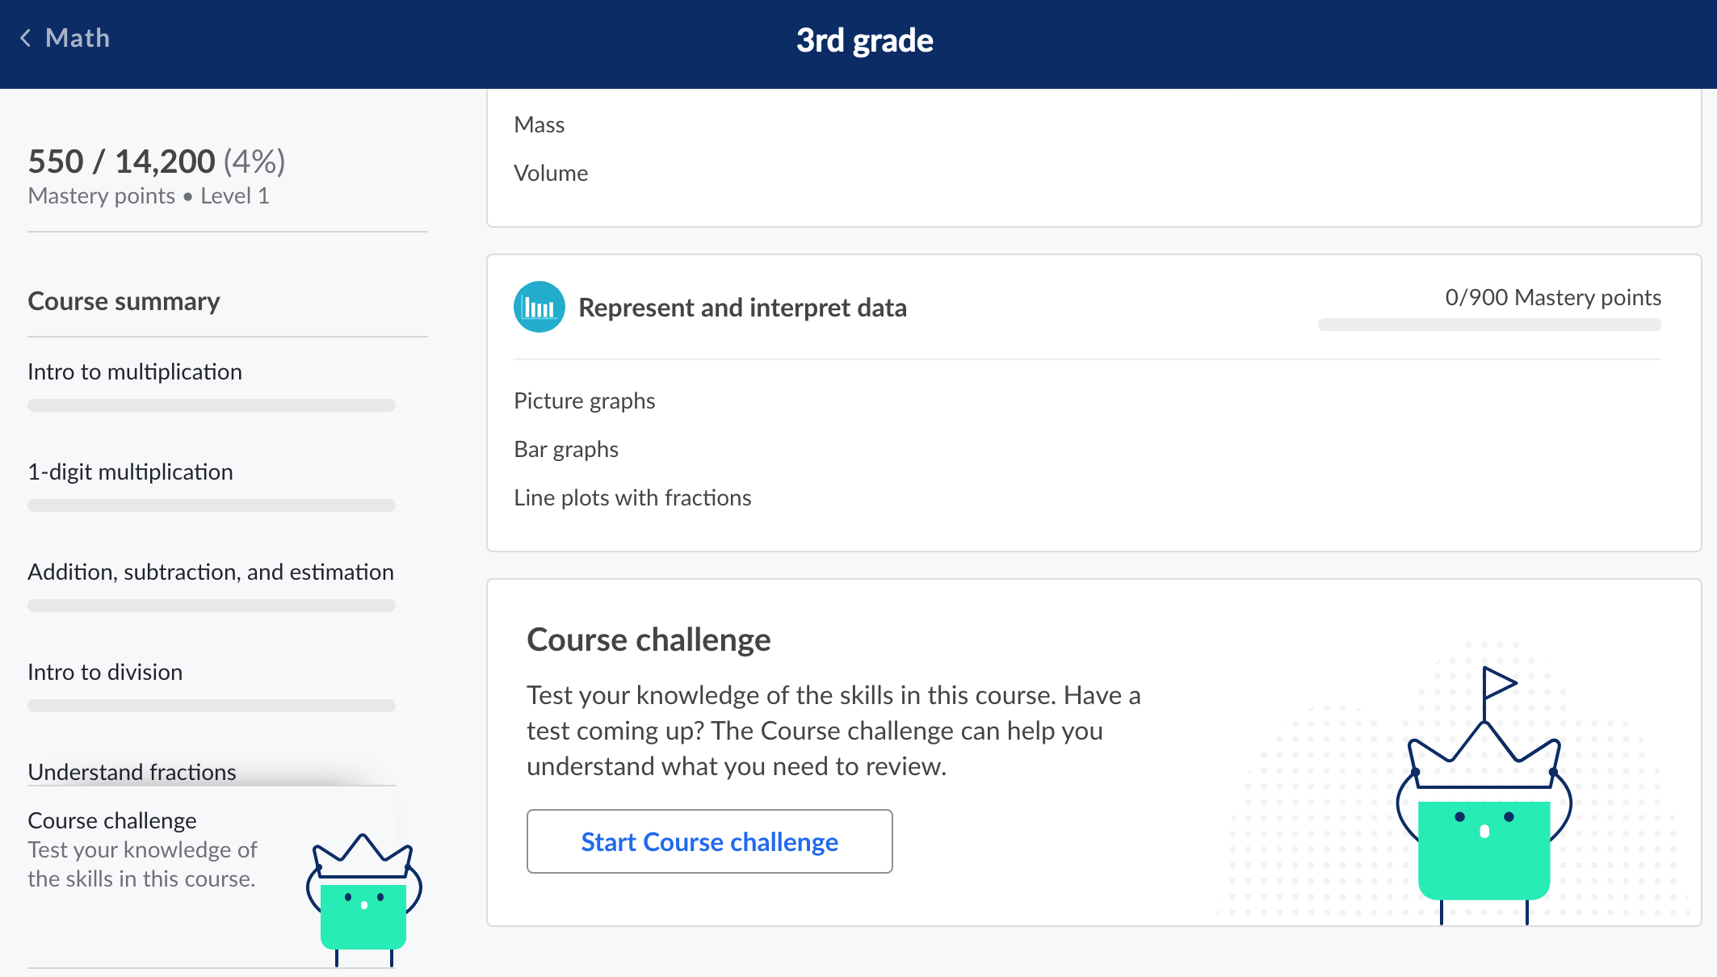
Reinforce 3rd grade skills
Khan Academy
Your child can complete the course challenge which will individualize lessons based on their needs

Slide 17
Skills to work on over the summer
Humanities
Typing
Reading chapter books and keeping track of characters and problems throughout the story
Discuss text after reading
Question stems resource
Reading and writing stamina
working up to 30 minutes
STEM
Fluency with multiplication and division
All facts with single digit factors
Multiplying by ten or a multiple of ten
3 x 10 = 30
If I know 2 x 5 = 10, then I also know 20 x 5 = 100
Game Resource

Slide 18
Questions?
Don't forget about the FAQ that was sent earlier!

