Slide 1
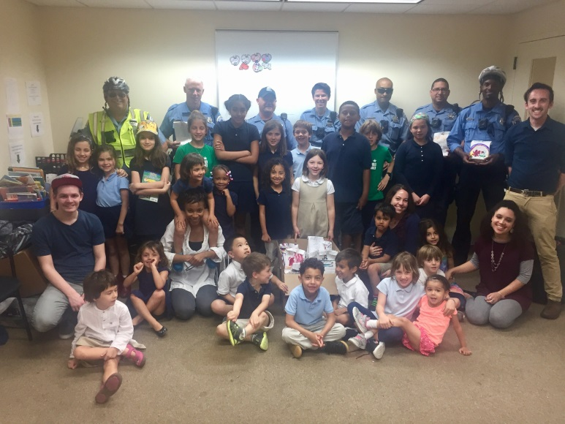
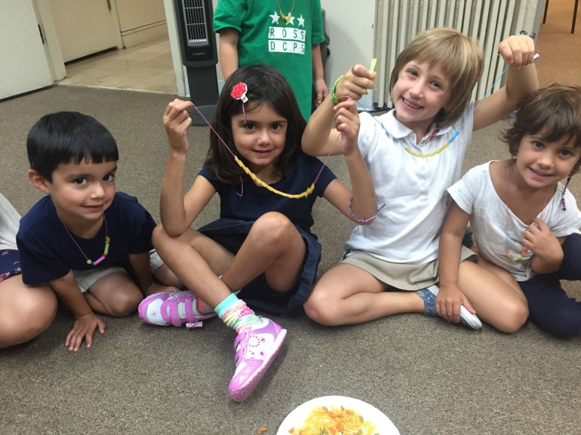
Edlavitch DC Jewish Community Center
Bini Silver - Chief Administrative Office
Stacey Herman - Director of School-Aged Programs
Director of Inclusion and Accessibility

Slide 2
Who are we?
Bini Silver - Chief Administrative Office
Over thirty years experience as an administrator in the educational field
Has been Head-of-School at four different Day Schools in the country
Has worked with children from birth – high school age and all types of families
Overseen programs with enrollment of over 1000 children
Has been at the DCJCC for six years
Stacey Herman - Director of School-Aged Programs
Previously an Elementary Special Education Teacher
Specifically worked with students with severe disabilities focused in Autism
Has worked in Camp, After School, and Educational programs for 14 years.
Has been working at the EDCJCC for almost 2 years. Elementary School Teacher for 5 years. Worked at JCC’s over 12 years

Slide 3
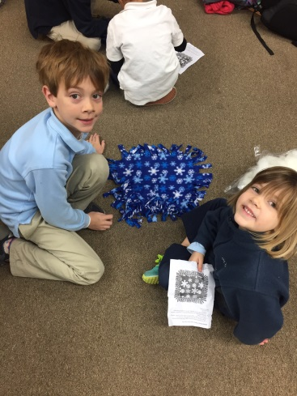
Traditional After School
A day in the life of your child:
* Structured Homework time for 2nd-5th grade students
* Healthy Snack provided
* Active Play: structured and engaging staff led games and activities, gross motor activities (in and outside)
* Quiet Room: Art, legos, foosball table, puzzles, books, small group games, board games, bingo, and more
Specialty Programs at the EDCJCC
* Healthy and Fitness with Coach D
* Art Specialty
* Social Justice: Community Service Projects
Theme weeks: i.e Community

Slide 4
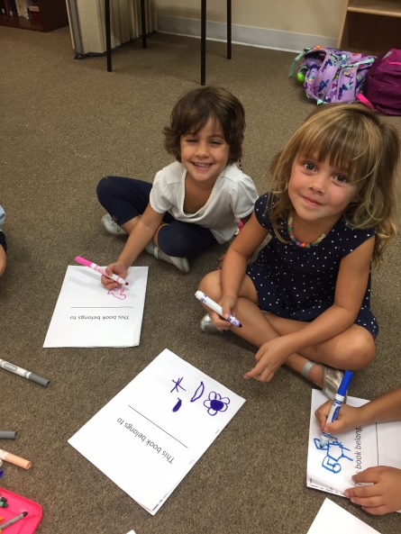
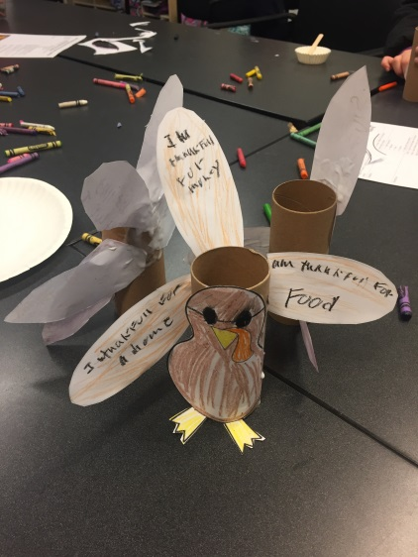
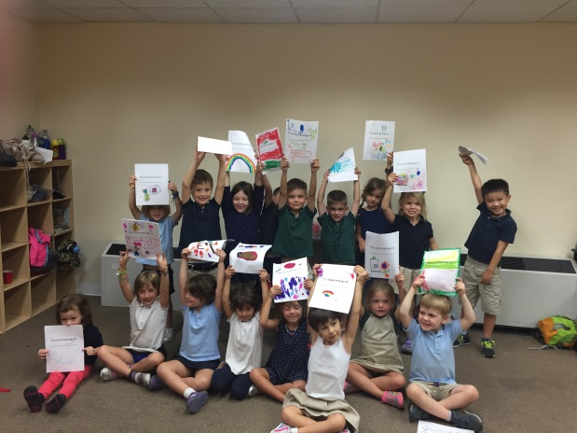
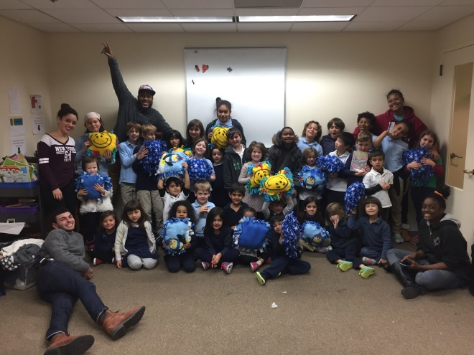
Social Justice: Community Service Specialty
This year we have…
* Written Letters to Seniors
* Made Fleece Pillows for children at NIH
* Created Busy Books for children at NIH
* Provided Police with Thank You kits
* Decorated bags for D25
* Made Superhero puppets for children at NIH
* Decorated bins and took in a collection for children at NIH
* Designed Thanksgiving Thank you Turkeys for Senior Luncheon
* Put together Decorations for the Film Departments Winter Lunch

Slide 5
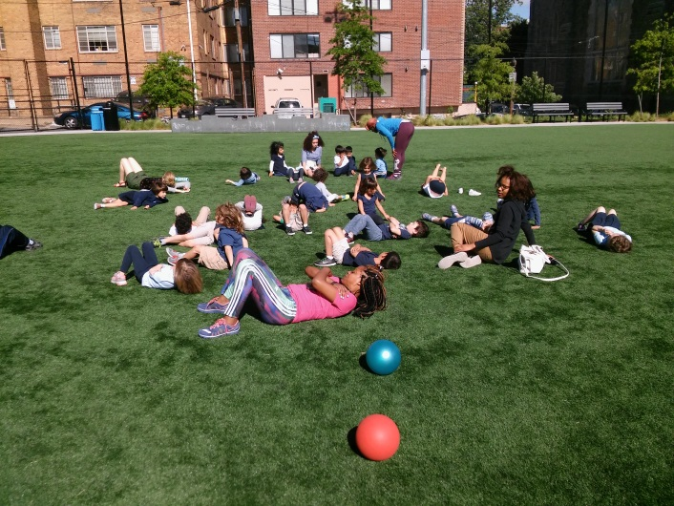
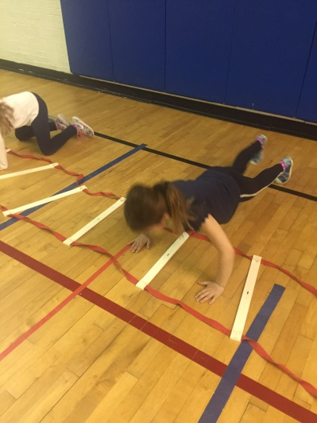
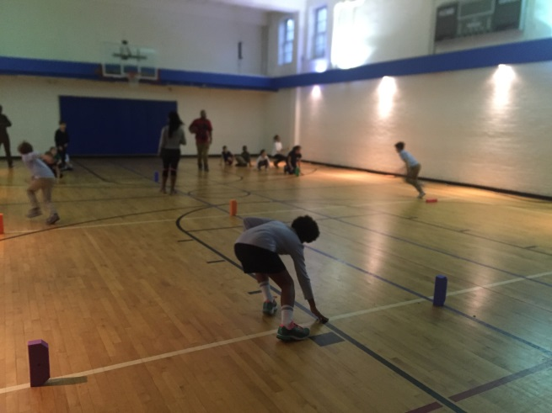
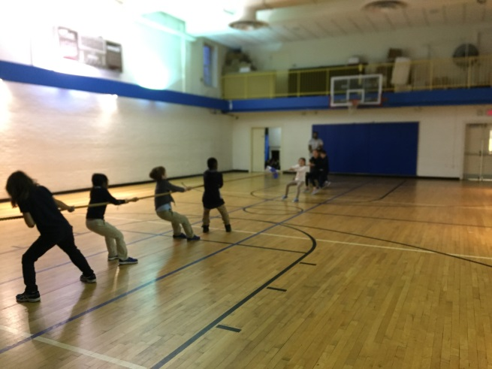
Health and Wellness with Coach D
This year we have…
Soccer
Kickball
Obstacles courses
Exercise classes
Red Rover
Relay Races
Parachute Games

Slide 6
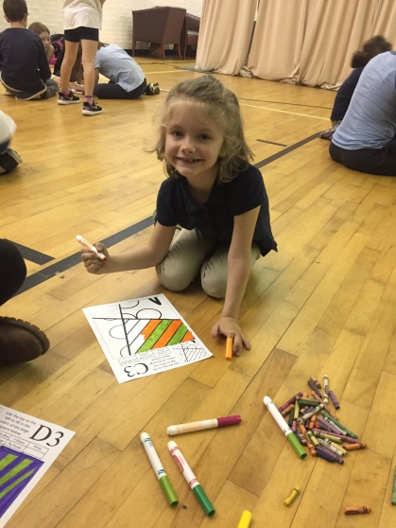
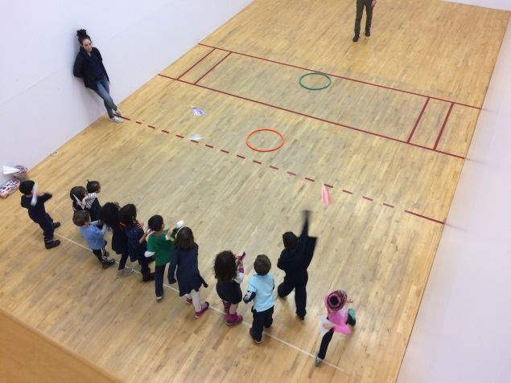
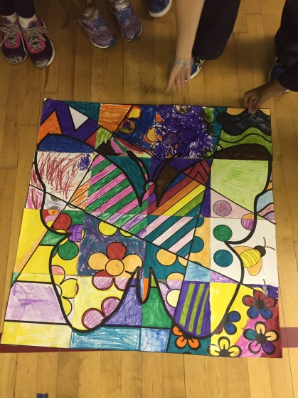
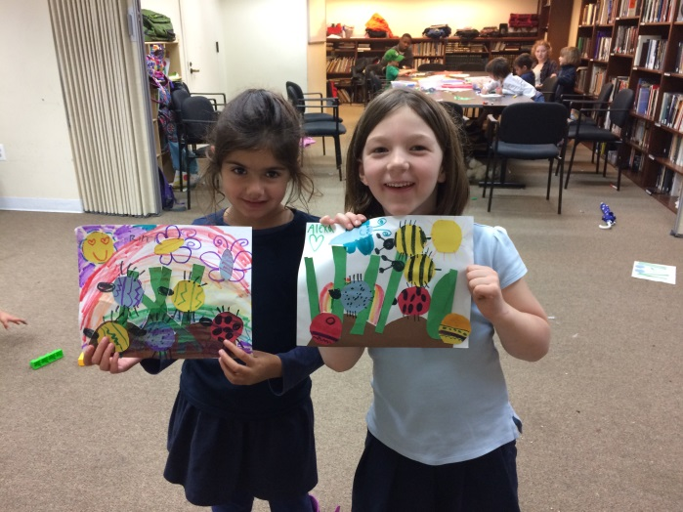
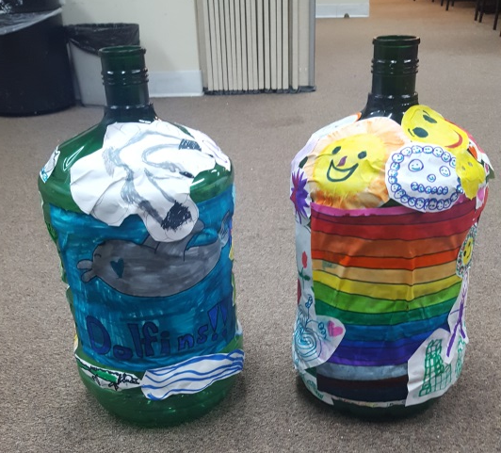
Art Specialty
This year we have made…
Tape Shapes
Teacups
Headbands
Treasure maps bandannas
Adventure in the Great Wide Somewhere (thumbprint dandelion)
Backyard Bugs
Butterfly Group Project
Scribble Art
Puddle Jumping (umbrella and rainy day scene)
Necklace Making
And so much more

Slide 7
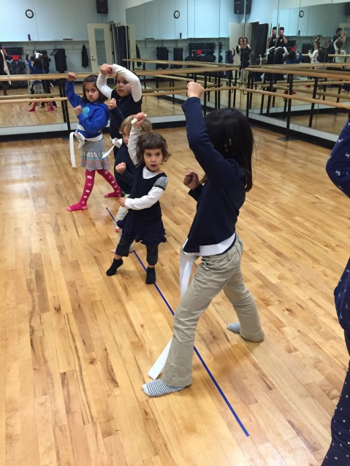
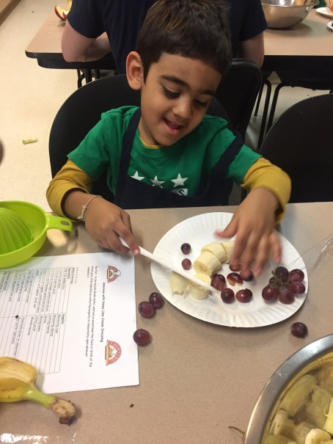
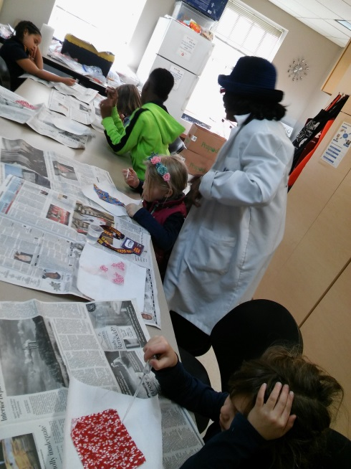
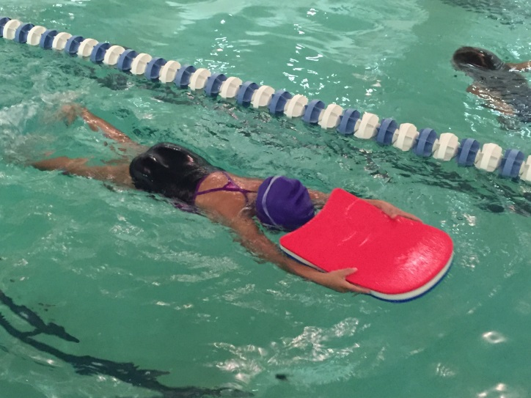
Enrichment Programs
Swimming
Mad Science
Chess
Lego Engineering
Spanish
Cooking
Yoga
* Coding (new)
* Financial literacy (new)
Karate
Theater
Ballet
Soccer
Keagan Theater Partnership

Slide 8
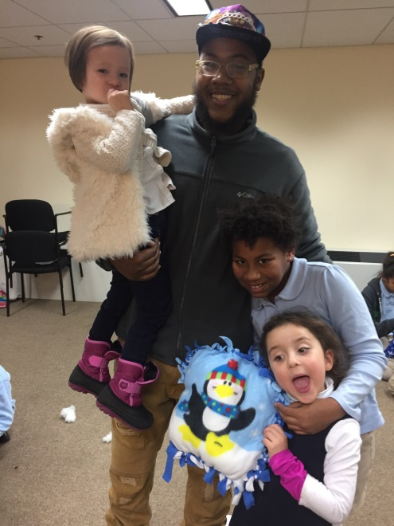
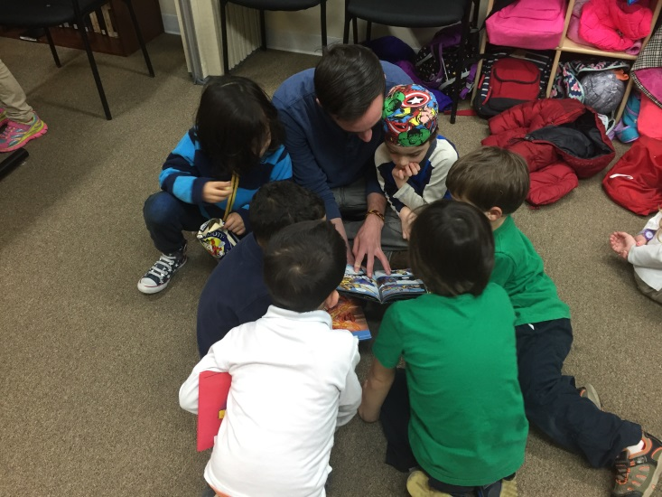
Our Amazing Staff
Many of our staff have been with us for the past few years
Diverse and Dedicated staff, invested in building personal relationships with each child
Invested in the personal growth of each child
We have staff that are employed by DCPS
All of our staff have a passion for working with children and providing an engaging experience
Our staff are reliable, well-trained, and are role models for the students
All of our staff are fingerprinted through the FBI database and go through an extensive background check

Slide 9
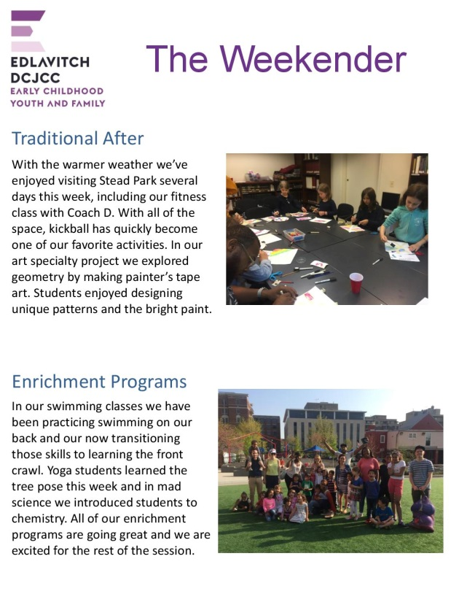
Communication
There are many ways we communicate with families on a weekly and daily basis. We know that communication is the key to a successful school-family partnership!
The Weekender (Friday): Weekly Newsletter, Program updates, Upcoming Family Programs, and more
Monday Mail: Program updates, Schedule Changes, and more
Enrichment and Weekly Schedule posted in Classroom 1
Electronic Monthly Traditional After School Sign-up
Electronic Change of Schedule Form
Electronic Change of Pick-up Authorization Form
Online Registration
Email communication with Director and Staff (prompt replies)

Slide 10
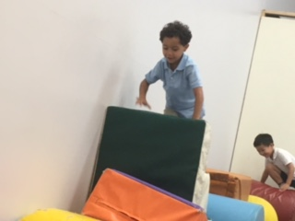
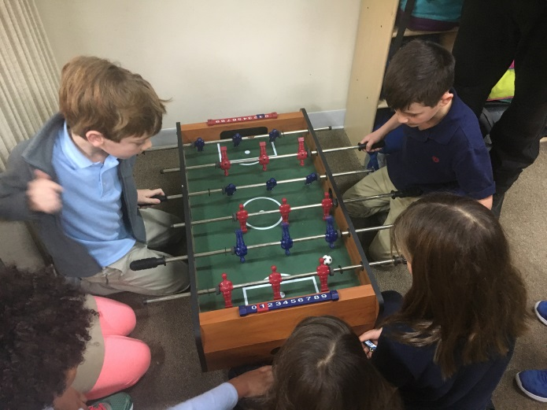
Parent Information
Traditional After School
$18 per day for Members
$21 per day for non-members
Enrichment Programs
Prices vary based on number of classes per session and vendor cost
Cost of Enrichment INCLUDES Traditional After School for the day.
You do NOT pay additional fee for Traditional After School for the day your child has an Enrichment.
We will be closed on Rosh Hashanah and Yom Kippur (3 days). We will have Traditional After School at Ross Elementary School for Sukkot, and Simchat Torah (4 days).
We will have Traditional After School at the EDCJCC the day before winter break and day before spring break.
Ross students registered for Traditional After School will be remaining on site at Ross Elementary School; these students should be picked up at Ross. Those students that will be in Enrichments will be walking over to the Edlavitch DCJCC, and will be picked-up from there.

Slide 11
What our families say about us!
“Stacey and her staff are the best. Our daughter loves going to JCC and we are thrilled with their programs!”
“I have been very impressed with the JCC after school program. The staff is very friendly, experienced and my child is very happy there. I wouldn't consider another aftercare option - period. Stacey Herman has been great to work with.”
“In our experience, the EDCJCC aftercare program is excellent in terms of caring for the children who attend the program and providing a safe, fun, and engaging environment for children. The staff and director communicate positively with the children and parents.”
“I cannot speak highly enough of the center. They offer great enriching and fun educational and sport programs. The staff is always courteous and kind, willing to go the extra mile to accommodate emergencies and family needs. I am always confident that my daughters are in good care. The EDCJCC is an essential part of the Ross community and they work collaboratively with the school to ensure that the transition from school to aftercare is smooth and safe.”
“The staff and director pay close attention to the individual needs of children and engage with parents in order to meet the needs of children who need a little extra help, direction, and focus. At pick up time - we witness the staff actively engaged with the kids - crafting, coloring, singing, playing, or reading. We are grateful for the amount of time, energy, compassion, and thought the EDCJCC staff spends with our children to help support them to feel successful, included, and most of all happy when they attend the program!”
“My girls enjoy going to the JCC for after school enrichments. Not only are they able to participate in activities they love -- from karate to swimming to cooking -- but they are able to do so in a loving, supportive environment with many of their friends. I am amazed at how much the JCC has invested in each individual child and their emotional growth and well being. Stacey and her staff has gone above and beyond to make my children feel loved and supported. I cannot say enough good things about the JCC.”
“Best option for after care in the area.”

